Slide 1
Performance test Reports
Submitted by TEAM BUG_INSPECTORS

Slide 2
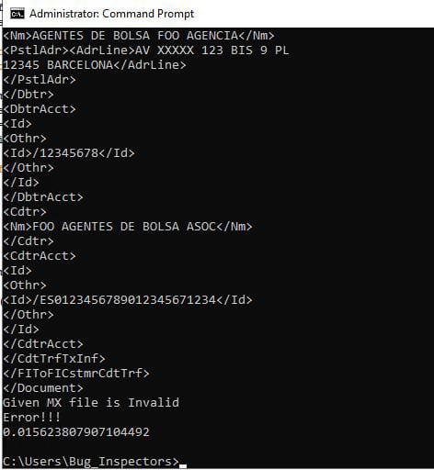
Average processing time
In order to process a single message file our program took 0.015623807907 seconds.
We calculated these results using time library in python.

Slide 3
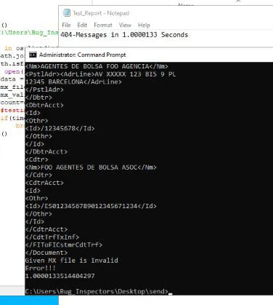
Messages processed per second
We were successfully able to process 404 messages in 1.0000133 seconds
The execution test was done using time library and conditional statements in python.

